Slide 1
Project Presentation
Car
Rental System

Slide 2
Problem Statement – Page 1
Introduction
The Car Rental Management System simplifies the car rental process, focusing on backend functionality. The system introduces distinct roles—User and Admin—to streamline operations efficiently.
Functional Requirements:
User Roles:
User:
Log in with a unique username and password.
Retrieve a list of available cars with detailed specifications.
Select a car and choose from different rental packages.
Initiate and complete secure payment transactions.
2. Admin:
Log in with admin credentials.
Access an Admin Dashboard for comprehensive system control.
Add, edit, or remove car listings and rental packages.
Generate detailed reports on rental activities.

Slide 3
Key Features
Car Listings:
Display a list of available cars with detailed specifications.
Include backend functionalities for adding, updating, and removing listings.
Package Selection:
Provide different rental packages for users to choose from.
Implement backend logic for package management.
Payment Options:
Implement backend processes for payment confirmation and record-keeping.
User Authentication:
Ensure secure user registration and login processes.
Dashboard for Managers and Admins:
Real-time monitoring of rental activities for Managers and Admins.
Streamlined backend interfaces for efficient fleet and transaction management.
Conclusion: The Car Rental Management System will offer a simplified and efficient solution for managing car rentals, catering to the needs of Users and Admins.

Slide 4
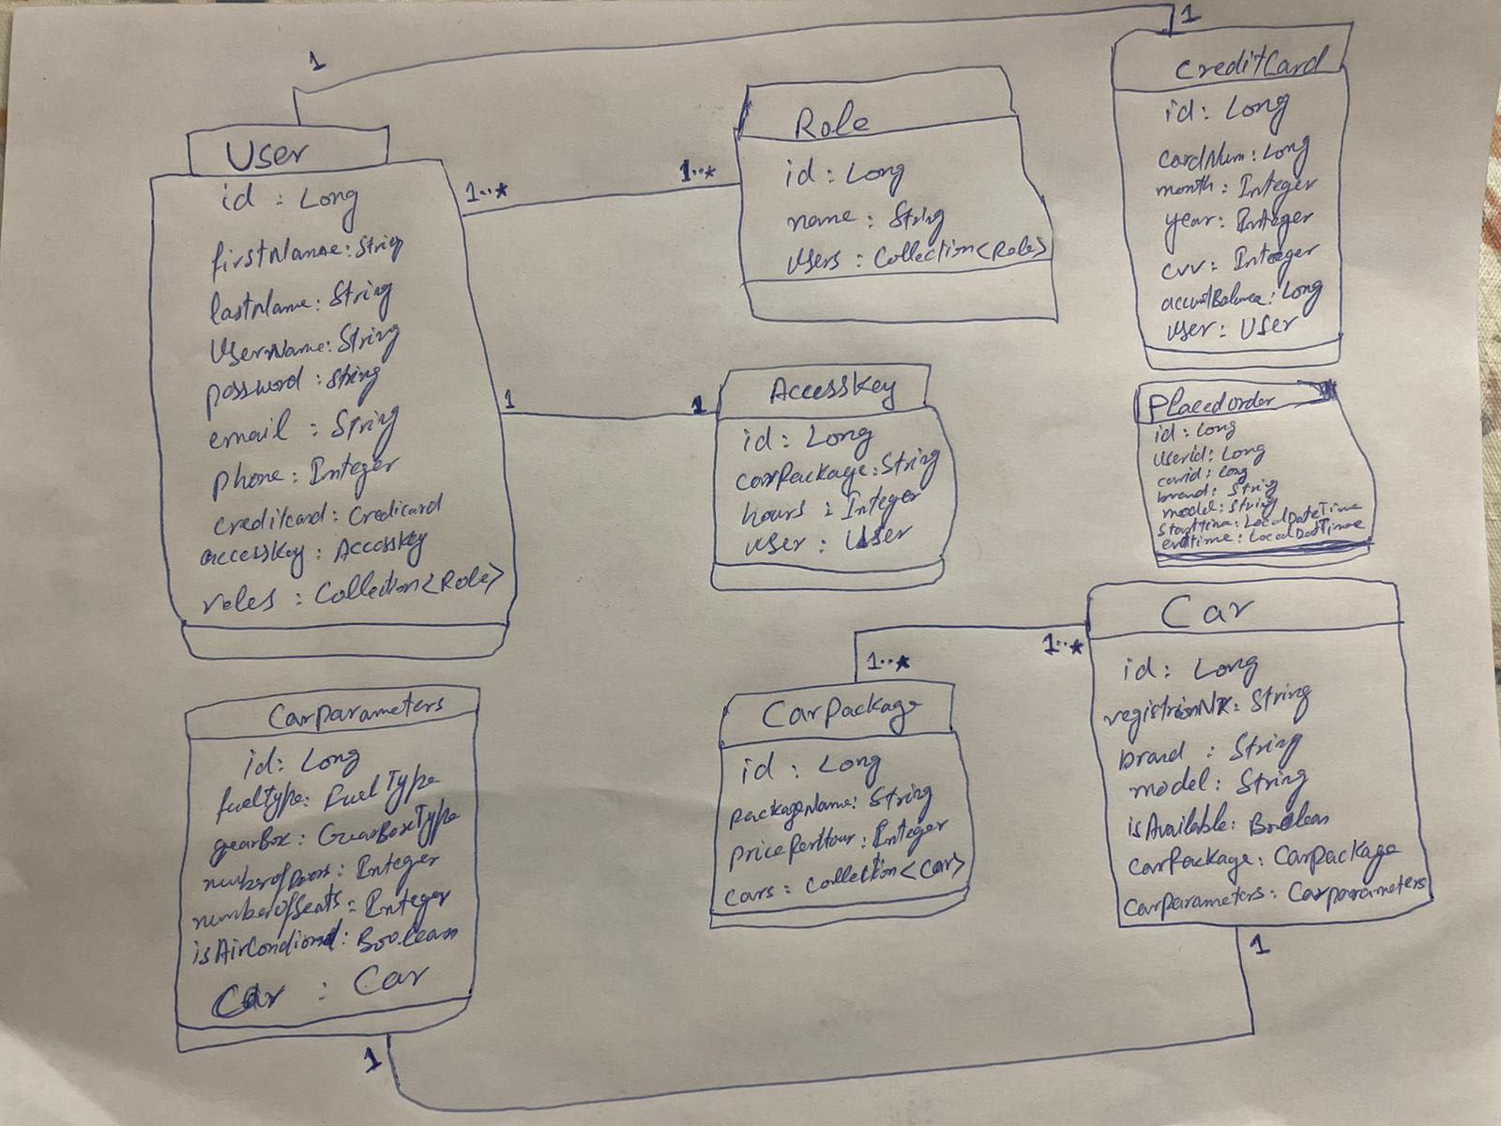
Class Diagram

Slide 5
The END
Let’s Go and check some Api’s and Code

